Slide 1
Arcane Adventure
Team 1-1: Grand Oso Wizards

Slide 2
Overview
Summary
Features
Flow Chart
Concept Art
Mock-ups
Demo?
What’s Next

Slide 3
Summary
A dark, evil has emerged in the outskirts of a medieval town and has attacked the countryside with its soldiers. Only Wiz, the Vigilant Sentinel, can defend the world from being overrun by evil!

Slide 4
Features
Single-player, side-scrolling action game
Three beautiful locations
Three enemy types
Randomization of enemy characters
Currency and upgrade systems
High scores

Slide 5
Flowchart

Slide 6

Concept Art
Three Scrolling Locations
Enchanted Forest
Cave
Village

Slide 7



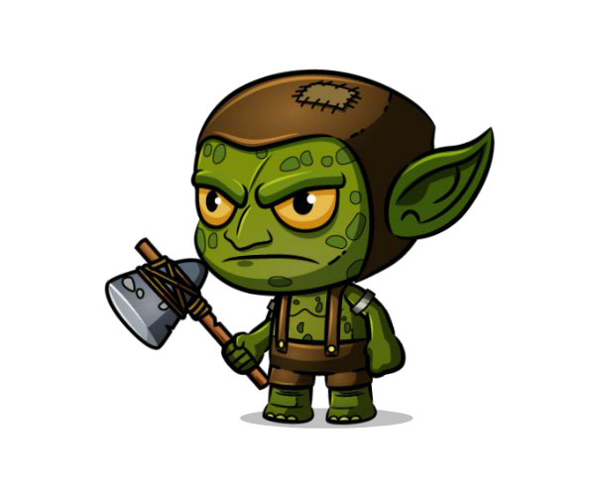
Concept Art
Main Character
Wizard
Three Enemy Types
Foot Ninja
Larger Ninja
Evil Villain
(Images may change)

Slide 8
Mock-Ups

Slide 9
Demo??

Slide 10
What’s Next
Prototype and Implement Currency and Upgrade Systems
Implement Menus
Implement High Scores
Test and Polish

